Slide 1
Elementary Particle Physics
Introduction
Dr. Darrel Smith

Slide 2
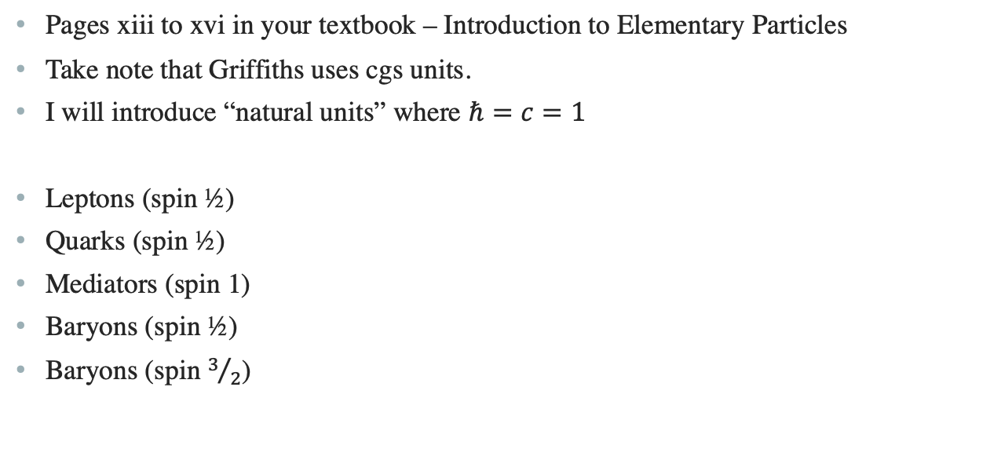
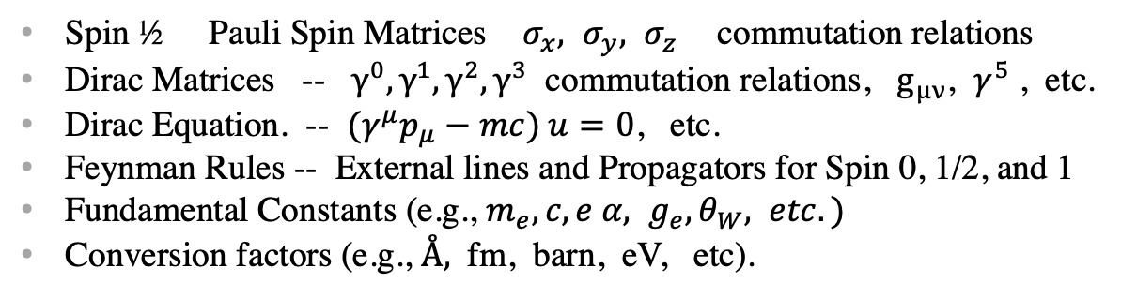
Units, Formulas and Constants
Pages xiii to xvi in your textbook – Introduction to Elementary Particles
Take note that Griffiths uses cgs units.
I will introduce “natural units” where $ℏ=c=1$
Leptons (spin ½)
Quarks (spin ½)
Mediators (spin 1)
Baryons (spin ½)
Baryons (spin $3/2$)
Pseudoscalar mesons (spin 0)
Vector Meson (spin 1)
Spin ½ Pauli Spin Matrices $σ_{x}, σ_{y}, σ_{z}$commutation relations
Dirac Matrices -- $γ^{0}, γ^{1}, γ^{2}, γ^{3}$ commutation relations, $g_{μν}$, $γ^{5}$ , etc.
Dirac Equation. -- ${(γ}^{μ}p_{μ}−mc) u=0$, etc.
Feynman Rules -- External lines and Propagators for Spin 0, 1/2, and 1
Fundamental Constants (e.g., $m_{e}, c, e α, g_{e}, θ_{W}, etc.)$
Conversion factors (e.g., $Å,$ fm, barn, eV, etc).

Slide 3
Introduction
What is matter made of? We will introduce the particles in Chapter 1.
How do they interact? This will be the rest of the book.
  Historical Introduction to the Elementary Particles
  Elementary Particle Dynamics
  Relativistic Kinematics. (Special Relativity, 4-vectors)
  Symmetries
  Bound States *
  The Feynman Calculus
  Quantum Electrodynamics
  Weak Interactions (chapter 9)
  Neutrino Oscillations. (chapter 11)
  * We may skip this chapter

Slide 4
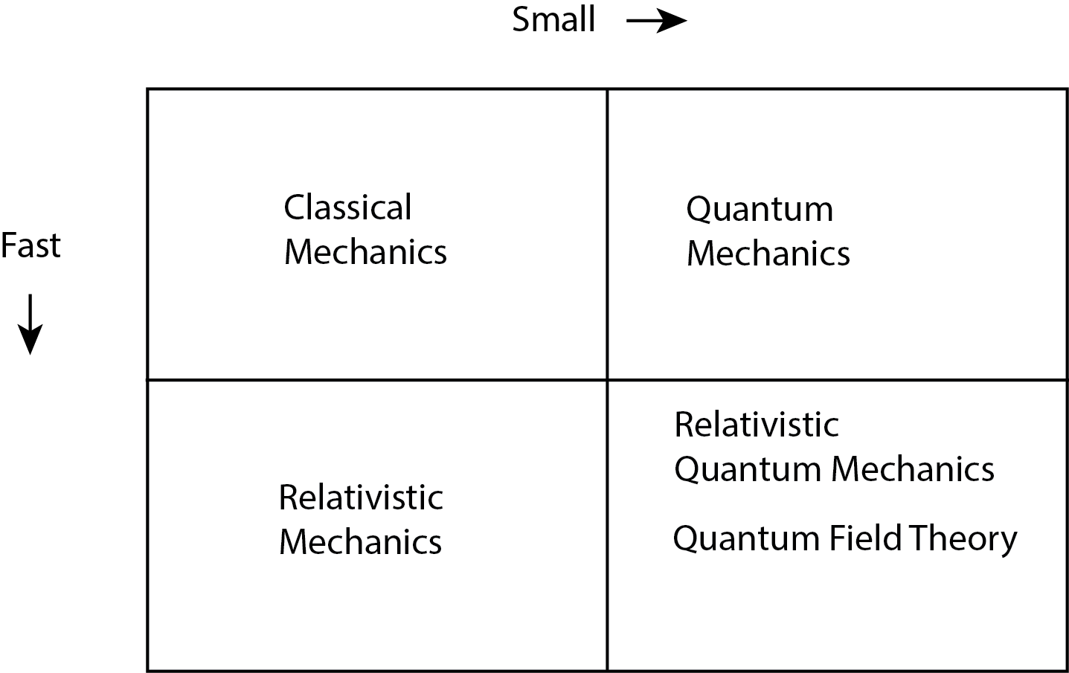
Introduction (cont’d)
The force law tells you what F is, and
the mechanics tells you how to use F to
determine the motion.
The Four Forces in Nature
Gravity
Electromagnetic
Weak
Strong
Antiparticles
CPT Theorem
Pauli Exclusion Principle

Slide 5
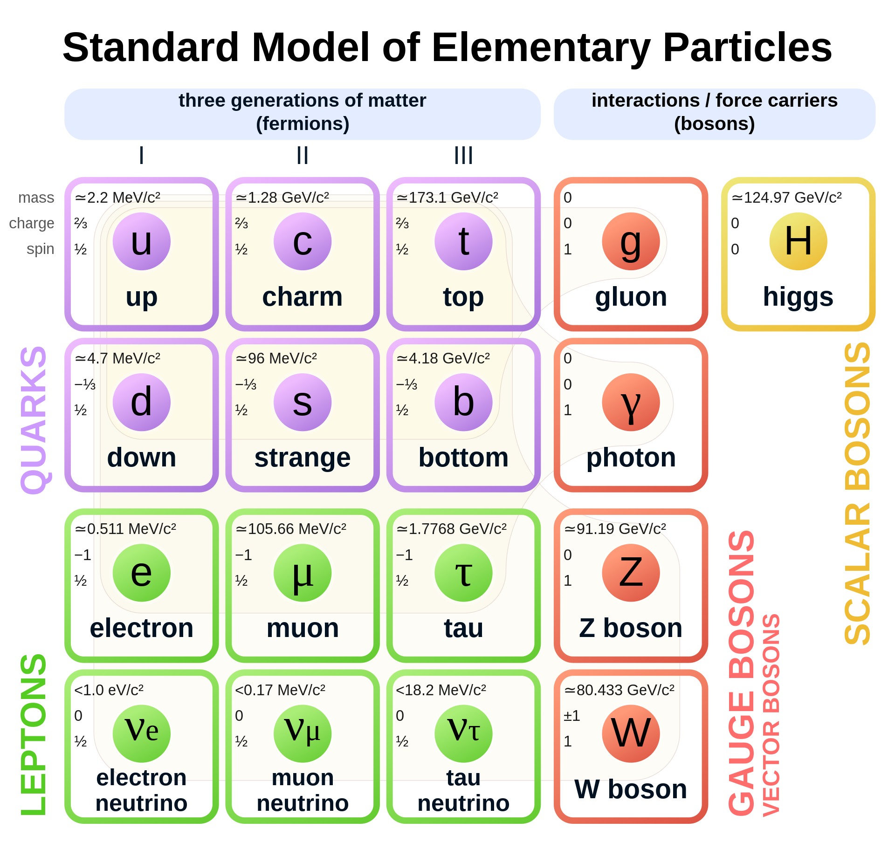
Introduction (cont’d)
The Standard Model
1. Quantum Electrodynamics (QED). Electromagnetic forces
2. Glashow-Weinberg-Salam theory
of weak interactions (GWS). Weak forces
3. Quantum Chromodynamics. (QCD). Strong forces

Slide 6
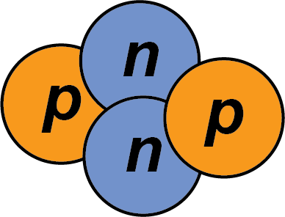


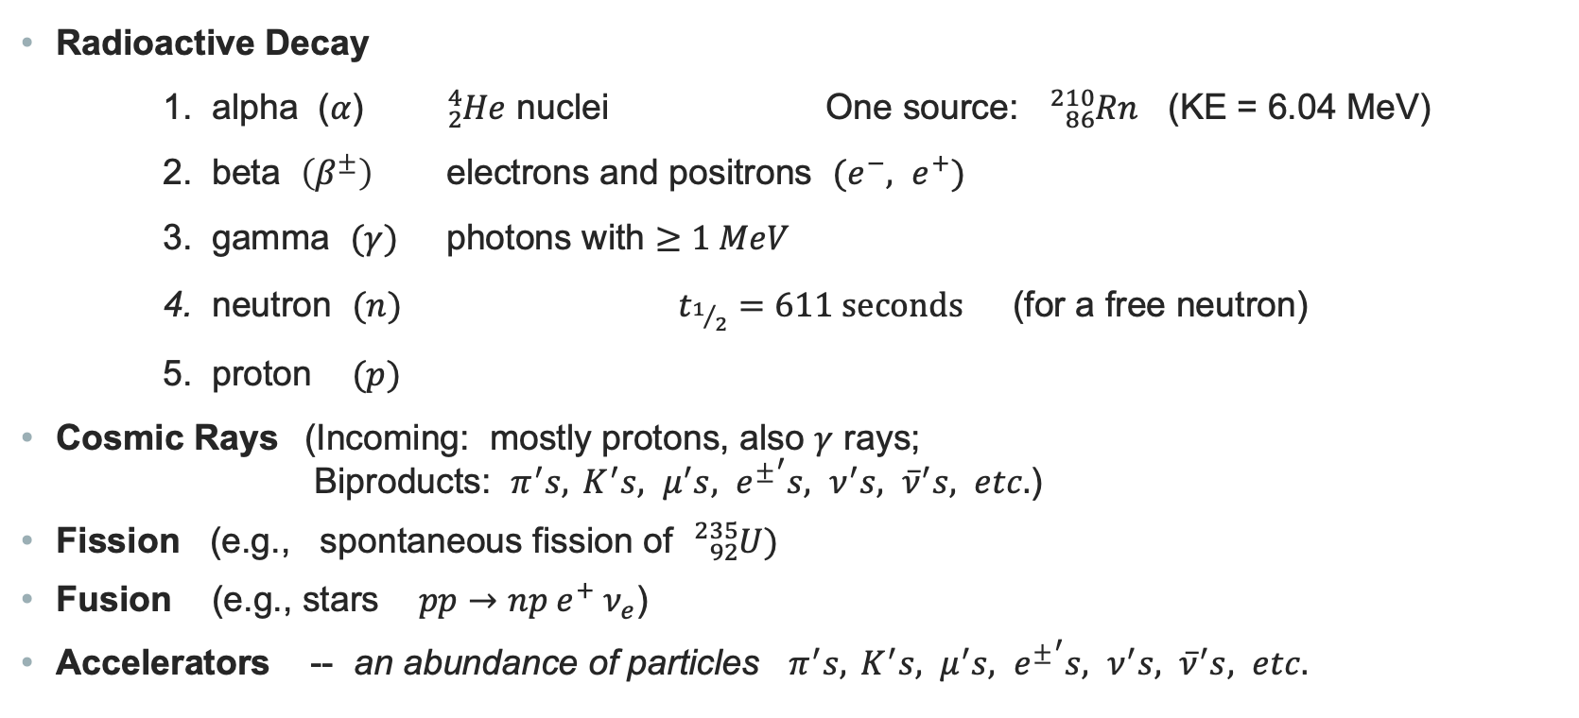
Sources of Elementary Particles
Radioactive Decay
1. alpha ($α$) ${}_{2}^{4}{He}$ nuclei One source: ${}_{86}^{210}{Rn}$ (KE = 6.04 MeV)
2. beta $\left(β^{±}\right)$ electrons and positrons $(e^{−}, e^{+})$
3. gamma $(γ)$ photons with $≥1 MeV$
4. neutron $(n)$ $t_{1/2}=611 seconds$ (for a free neutron)
5. proton $(p)$
Cosmic Rays (Incoming: mostly protons, also $γ$ rays;
Biproducts: $π^{′}s, { K}^{′}s, μ^{′}s, {e^{±}}^{′}s, ν^{′}s, {\overline{ν}}^{′}s, etc.$)
Fission (e.g., spontaneous fission of ${}_{92}^{235}U)$
Fusion (e.g., stars $pp→np e^{+} ν_{e}$)
Accelerators -- an abundance of particles $π^{′}s, { K}^{′}s, μ^{′}s, {e^{±}}^{′}s, ν^{′}s, {\overline{ν}}^{′}s, etc.$

Slide 7
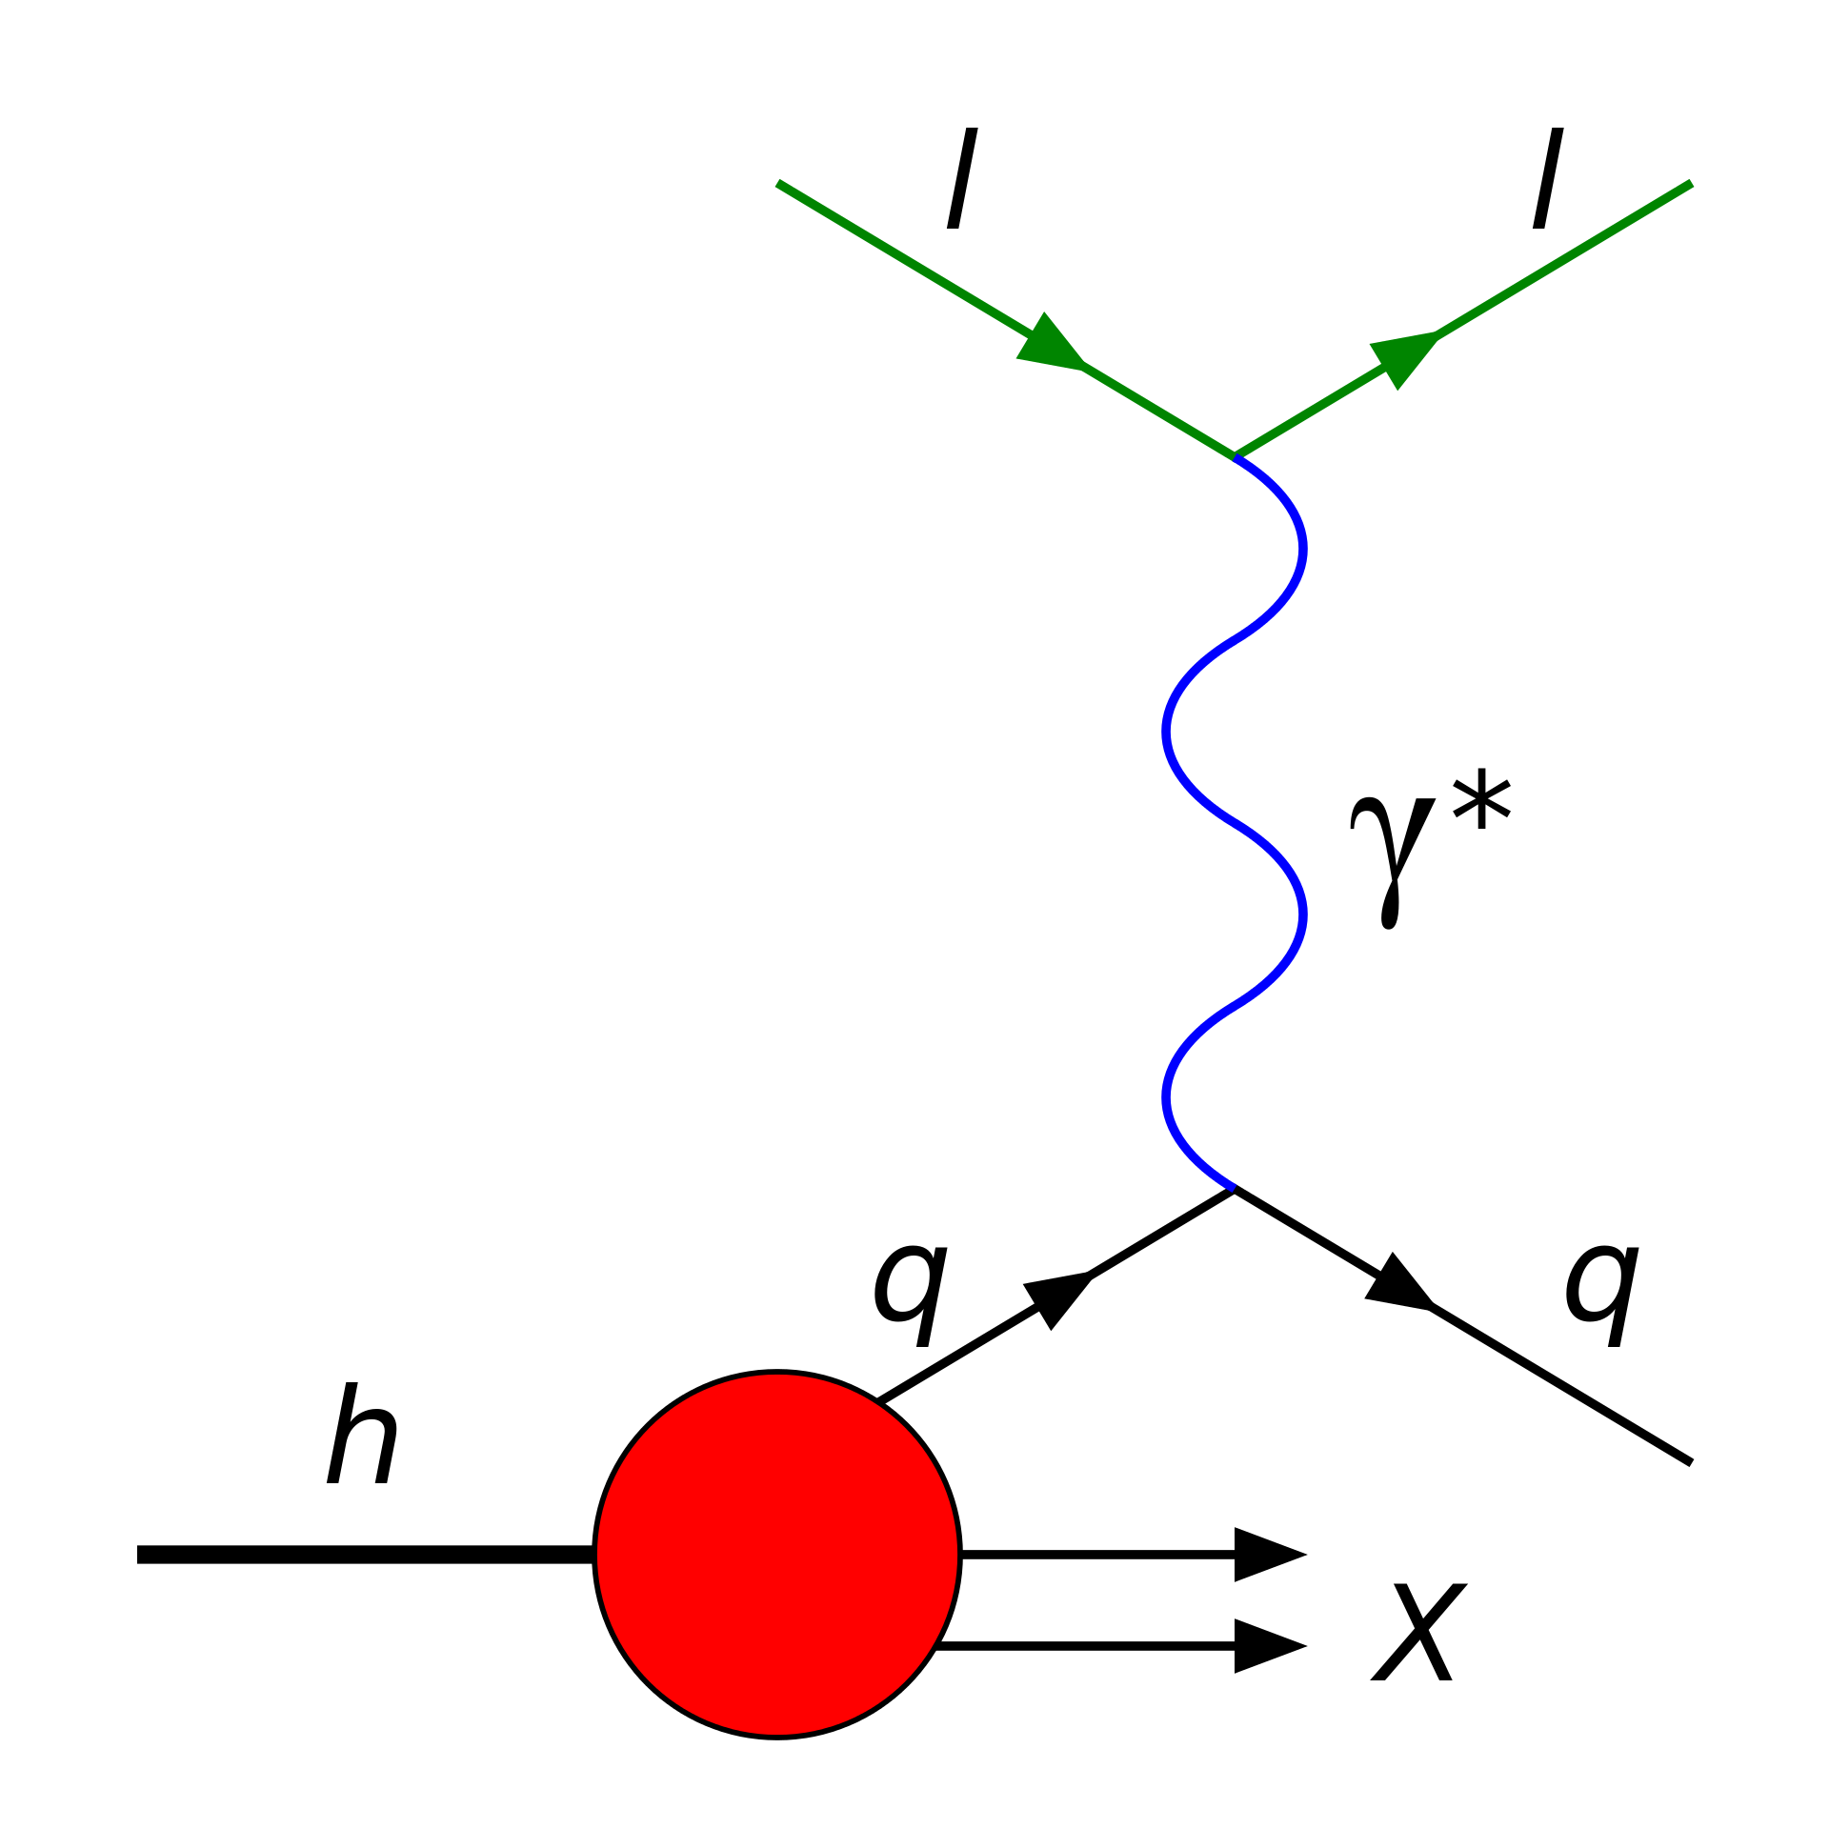
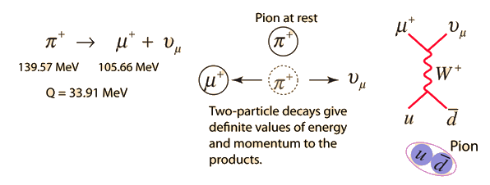
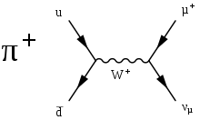
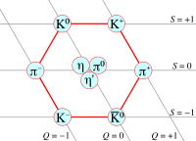



Sources of Experimental Information
Scattering Events
For example: Deep Inelastic Scattering
Record and interpret the energy and angle
of the incoming and outgoing lepton.
Decays (spontaneous disintegration)
Bound states (composite objects)
Many particles are composite objects
$$p (uud)$$
The Eight-fold Way
$$π^{+} (u\overline{d})$$
$$K^{−} (\overline{u}s)$$

Slide 8
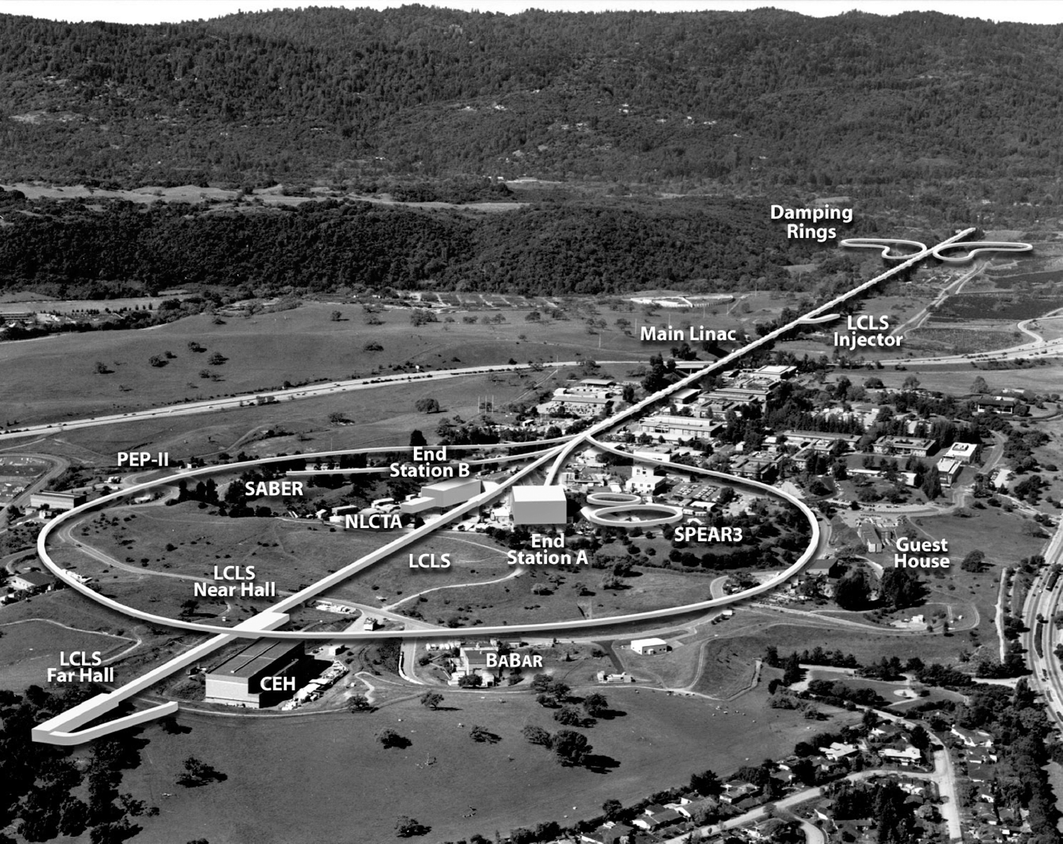
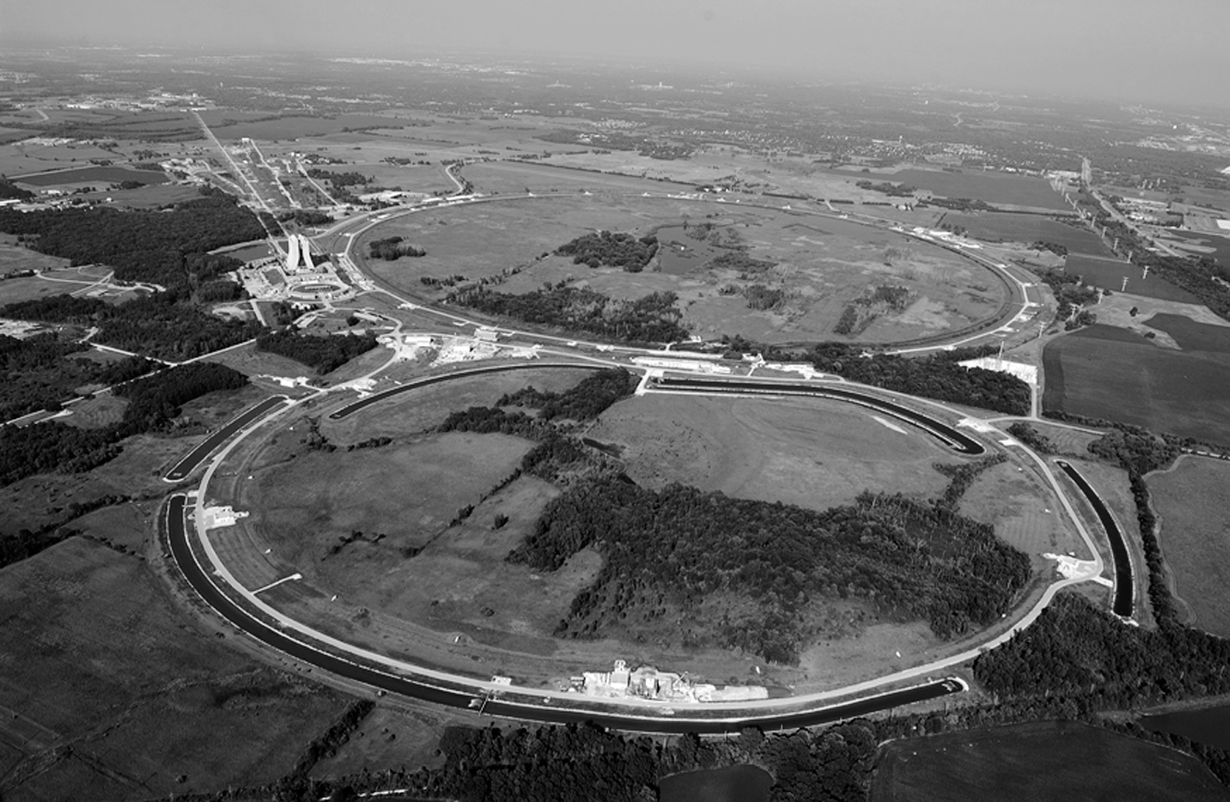
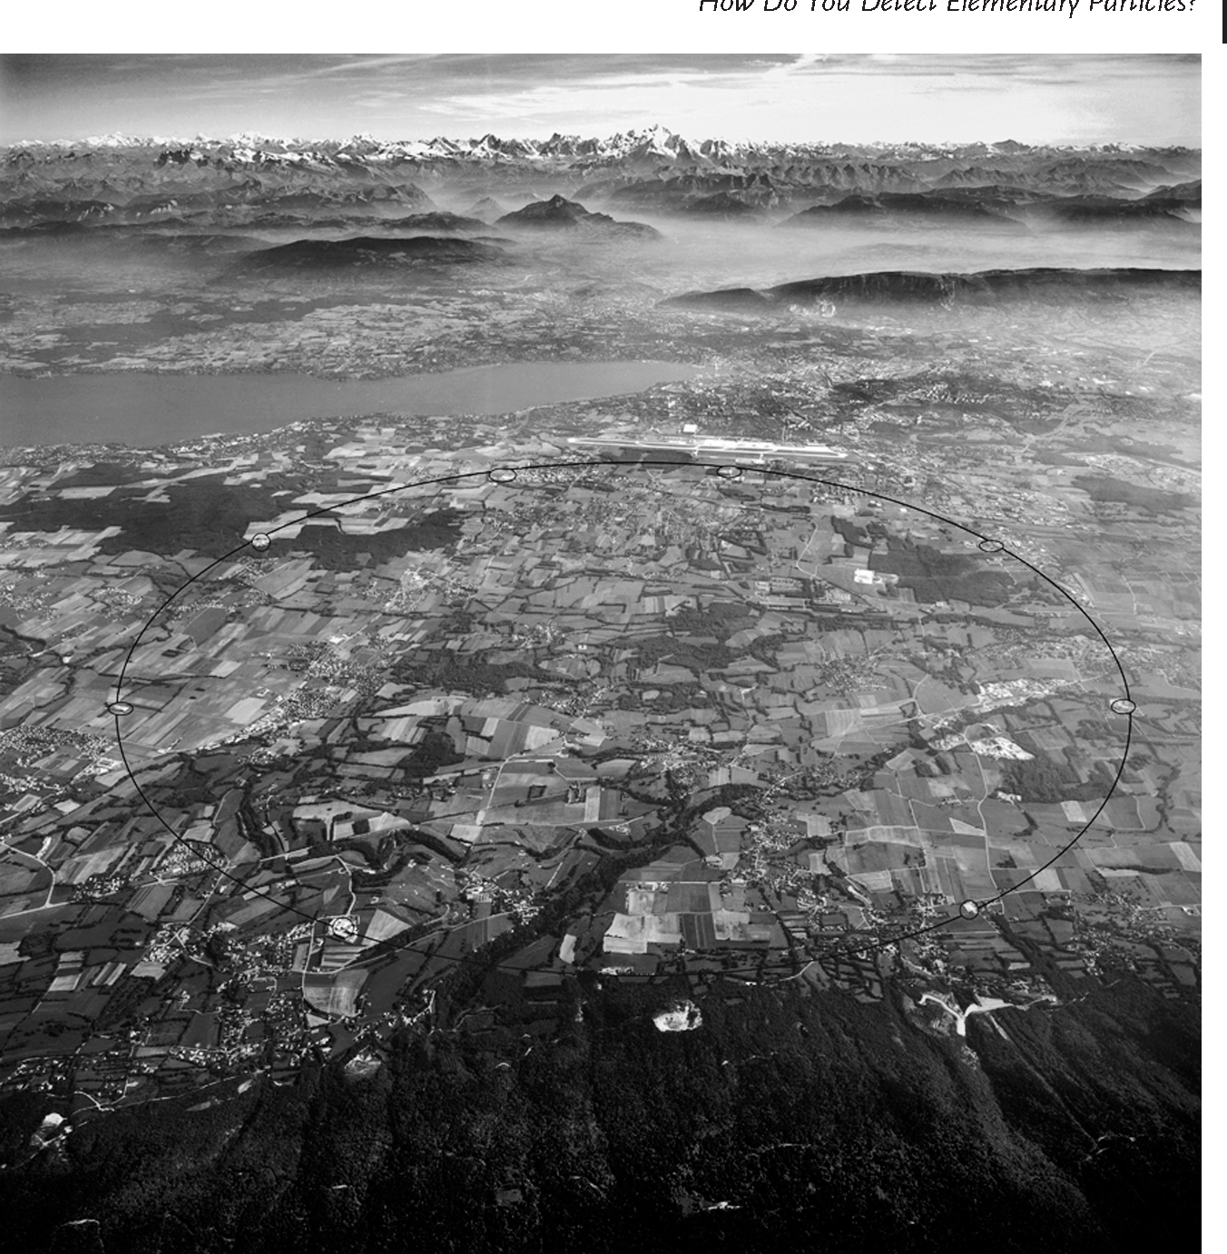

Accelerators
SLAC
Linear Accelerators. (Linacs)
Stanford Linear Accelerator Center (SLAC)
$\sqrt{s} =$ center-of-mass energy = 90 GeV
Circular Accelerators
Tevatron at Fermilab (FNAL)
$\sqrt{s} =$ 2 TeV
Large Hadron Collider (LHC)
at CERN
$\sqrt{s} =$ 14 TeV
Fermilab
CERN

Slide 9
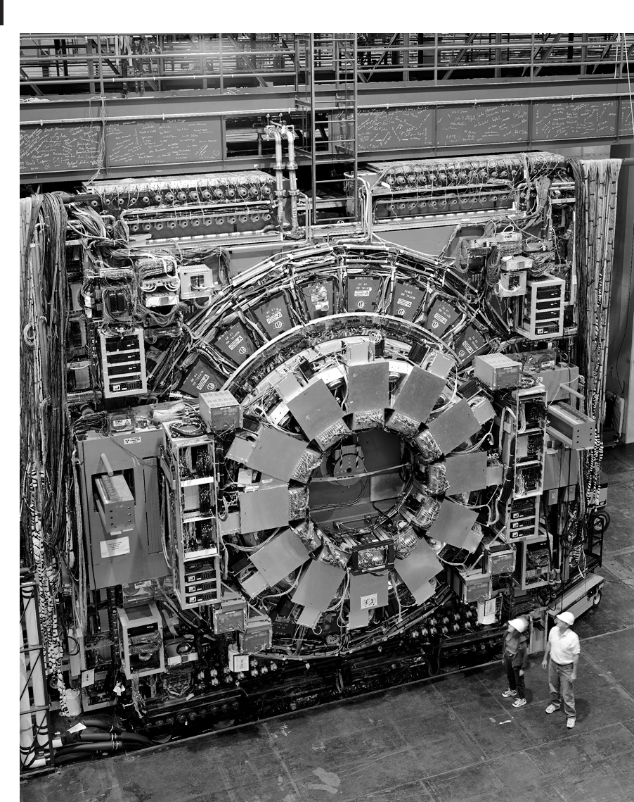
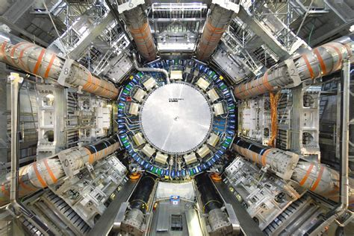
Detectors
CDF Detector at Fermilab
Discovery of the top quark (t) 1995
mass of the top quark = 173 GeV/c²
ATLAS at CERN
Discovery of the Higgs boson (H)
July 4, 2012
mass of the Higgs boson = 125 GeV/c²
CDF
ATLAS

Slide 10



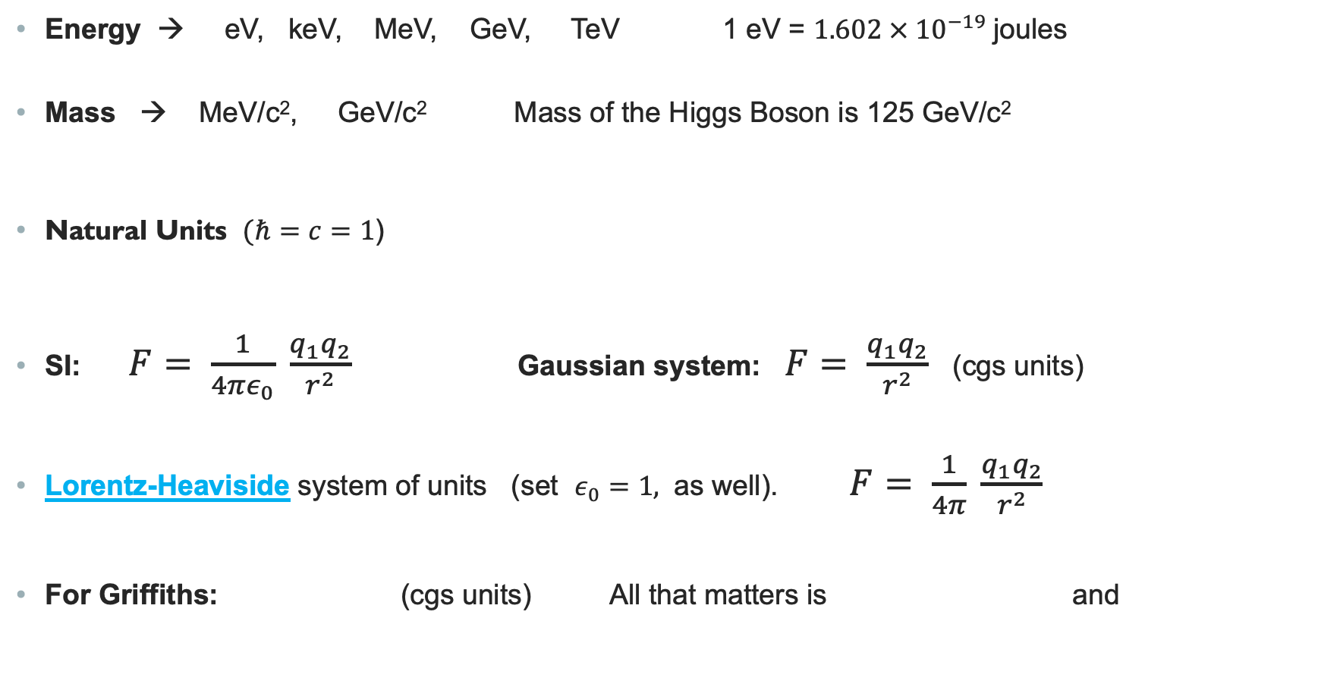
Units
Energy → eV, keV, MeV, GeV, TeV 1 eV = $1.602 × {10}^{−19}$joules
Mass → MeV/c², GeV/c² Mass of the Higgs Boson is 125 GeV/c²
Natural Units $(ℏ=c=1$)
SI: $F= \frac{1}{4πε_{0}} \frac{q_{1}q_{2}}{r^{2}}$ Gaussian system: $F= \frac{q_{1}q_{2}}{r^{2}}$ (cgs units)
Lorentz-Heaviside system of units (set $ε_{0}=1,$ as well). $F= \frac{1}{4π} \frac{q_{1}q_{2}}{r^{2}}$
For Griffiths: (cgs units) All that matters is and

Slide 11

Units and Other Things
The PDG Particle Physics Booklet http://pdg.lbl.gov
You are expected to know certain constants, because you are going to use them so much.
For Example, $m_{e}$, $m_{p}$, $ℏc$, $α$, $1$barn, and the list will expand. And you will know these constants
in natural units.

